Slide 1
BISSIT 2022 HANDWRITTEN CHARACTER RECOGNITION PROJECT TEAM 1 - “ 404 - Name Not Found”

Slide 2
Introduction of team members
An jihyeon – ppt
Vojtěch Mimochodek – code
Park Jiwon - ppt
Mwangi Caroline Wambui – report, presentation
Lee JuHyun – code

Slide 3
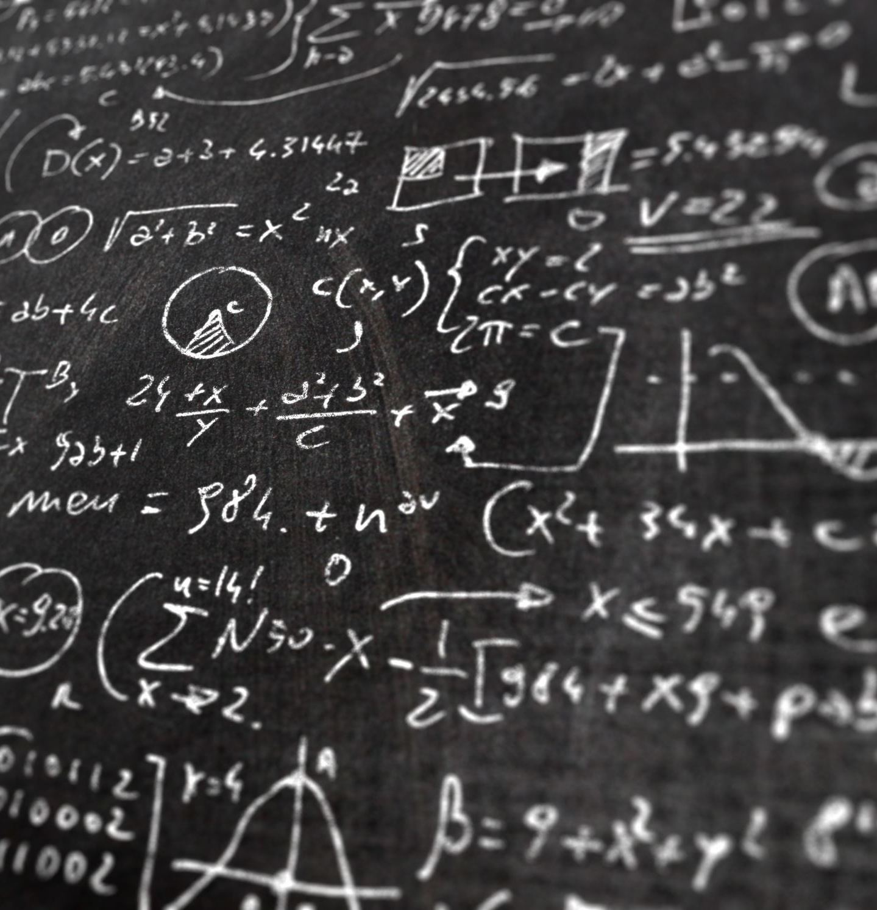
PROBLEM DEFINITION
This handwritten character recognition project is a machine learning system that aims to recognize characters i.e. letters or numbers written by hand on a piece of paper and predict the characters.

Slide 4
SOLUTION
The recognition of these characters was done by using a machine learning algorithm, convoluted neural network (CNN), to process the images of the handwritten characters and predict the output by passing these images through convolution layers and pooling layers.

Slide 5
DATASET
Handwritten character images from the MNIST dataset were used for training and validation of the model and then we came up with our own handwritten written character images for testing purposes.
Results of the above process will be included below.

Slide 6
MODEL
The model is basically a convolutional neural network with three convolution layers and max pooling layers. The activation function used is ReLU and softmax. Calculation of the model’s loss is done using cross-entropy.

Slide 7
LIBRARIES USED
TensorFlow
Matplotlib
Keras
Numpy
Sklearn
openCV

Slide 8
Train Code Description
1. load dataset
2. normalize
3. set model
4. diagnostics
5. performance
6. train

Slide 9
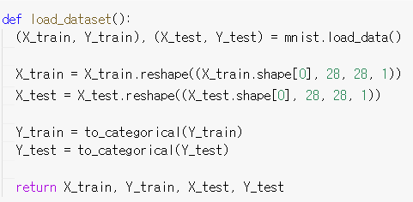
Train Code Description - load dataset
LOAD THE EMNIST DATASET
RESHAPE DATASET TO HAVE ONLY ONE CHANNEL
ONE HOT ENCODE

Slide 10
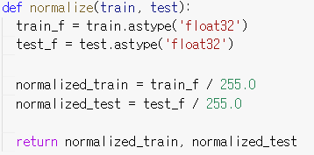
Train Code Description - normalize
CONVERT INTEGERS TO FLOATS
NORMALIZE

Slide 11
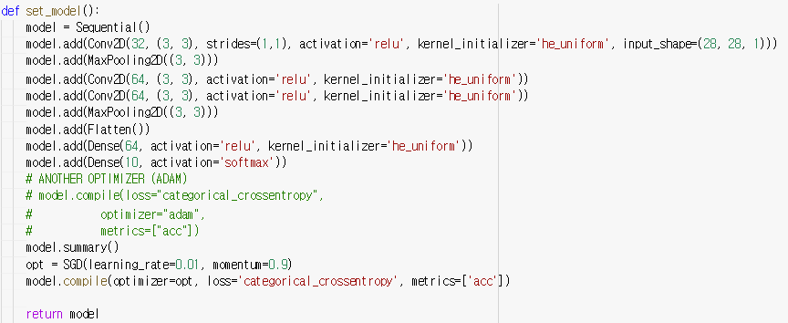
Train Code Description – set model
DEFINE NEURAL NETWORK MODEL

Slide 12
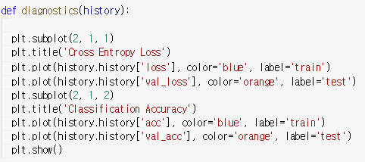
Train Code Description – diagnostics
SUMMARIZE DIAGNOSTICS

Slide 13
Train Code Description – performance
SUMMARIZE PERFORMANCE

Slide 14
Train Code Description – train
LOAD DATASED
PREPARE IMAGE - TYPE CONVERSE, NORMALIZE
DEFINE NEURAL NETWORK MODEL
TRAIN NEURAL NETWORK
SAVE MODE

Slide 15
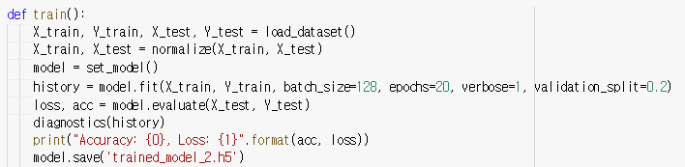
Train Code Description – train

Slide 16
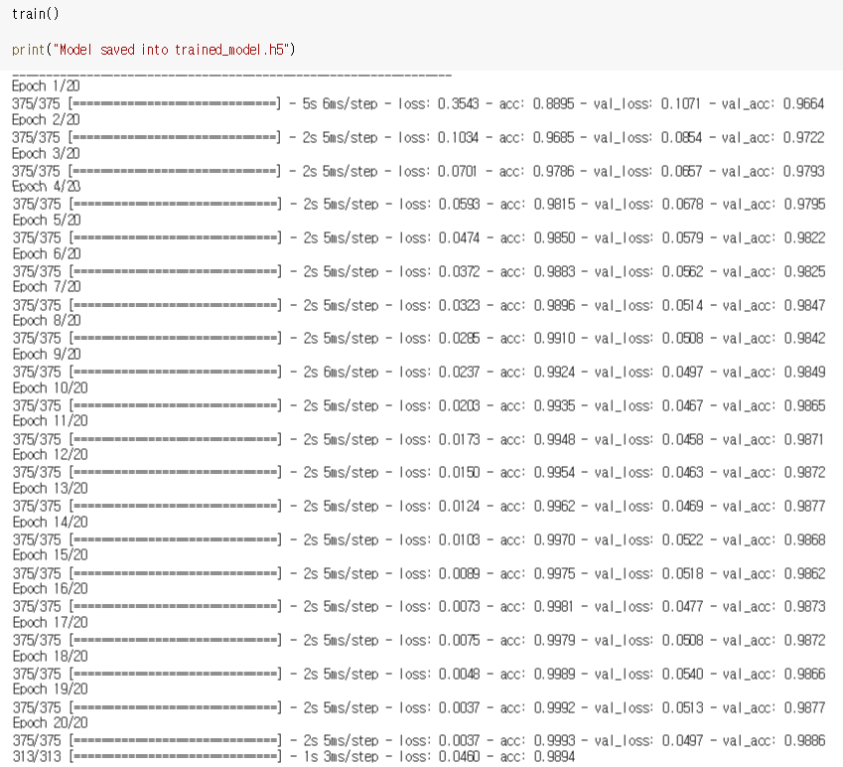
Train Code Description – train

Slide 17
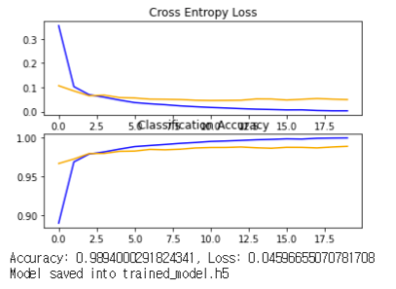
Train Code Description – train

Slide 18
Main Code Description
1. import, etc
2. find digit
3. evaluate
4. test all
5. test single

Slide 19
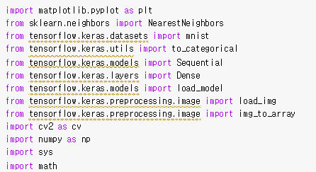
Main Code Description - import, etc

Slide 20
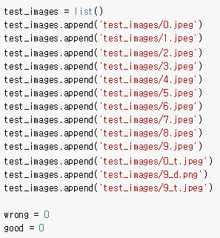
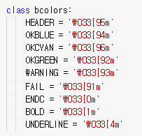
Main Code Description - import, etc

Slide 21

Main Code Description – find digit

Slide 22
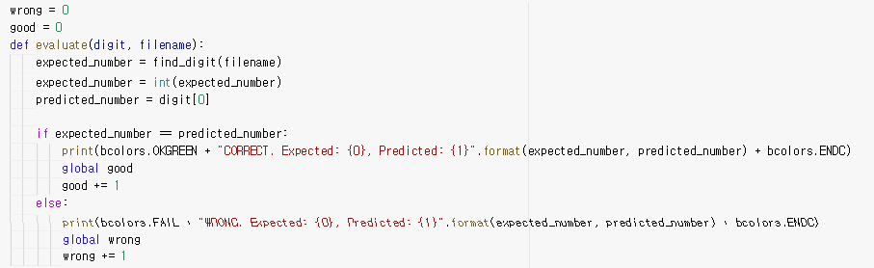
Main Code Description – evalulate

Slide 23
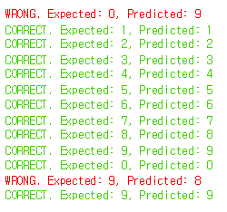
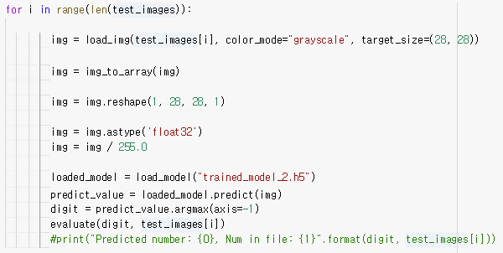
Main Code Description – test all

Slide 24
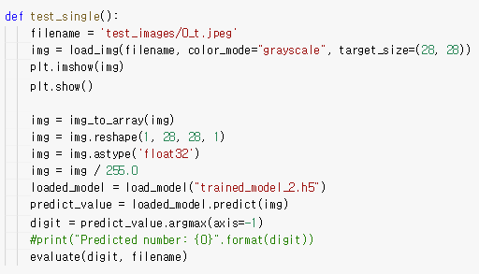
Main Code Description – test single

Slide 25
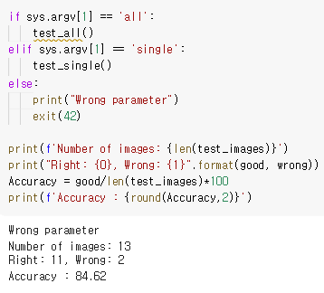
Main Code Description – test single

Slide 26
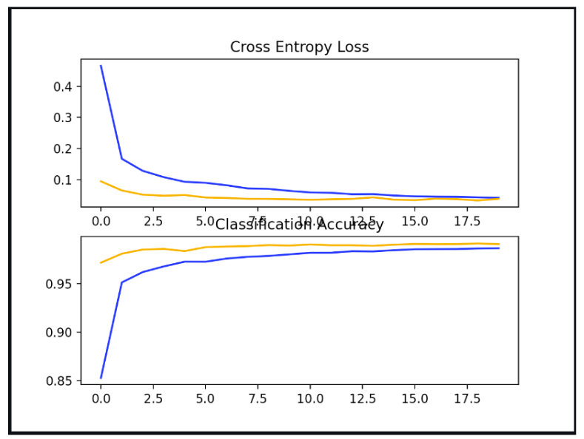
RESULTS/CONCLUSION
Below are two graphs showing the loss and accuracy trends during the training process:

Slide 27
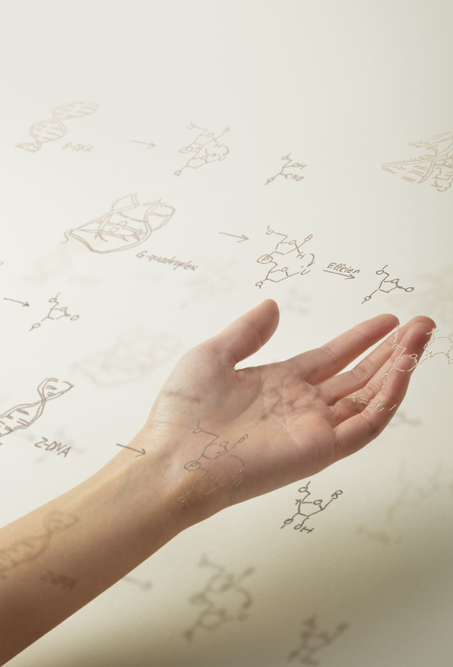
RESULTS/CONCLUSION
During the testing phase, our model was able to recognize pretty big and wide handwritten characters. We observed that loading and resizing of the images can invalidate the images leading to subsequent misrecognition of images.
Some examples of images that were recognized and those that were not recognized are shown :

Slide 28
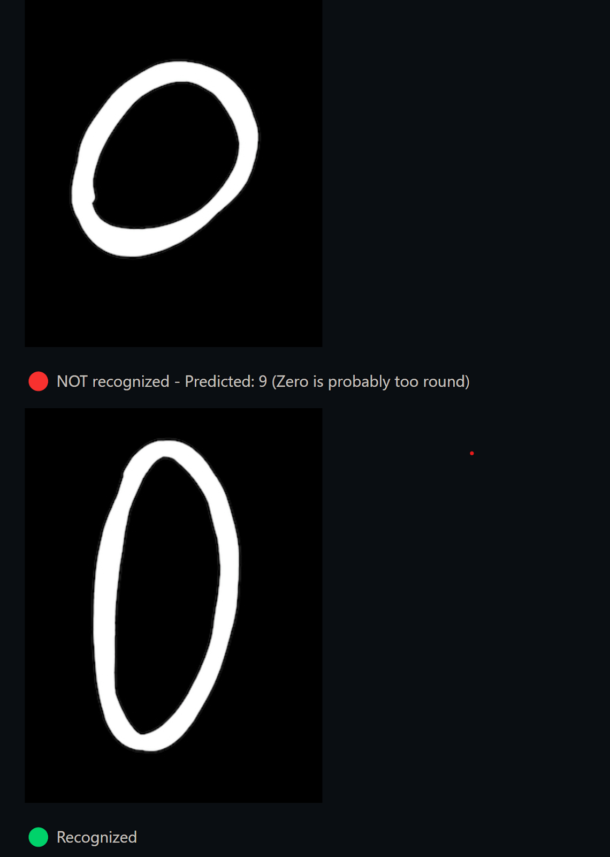

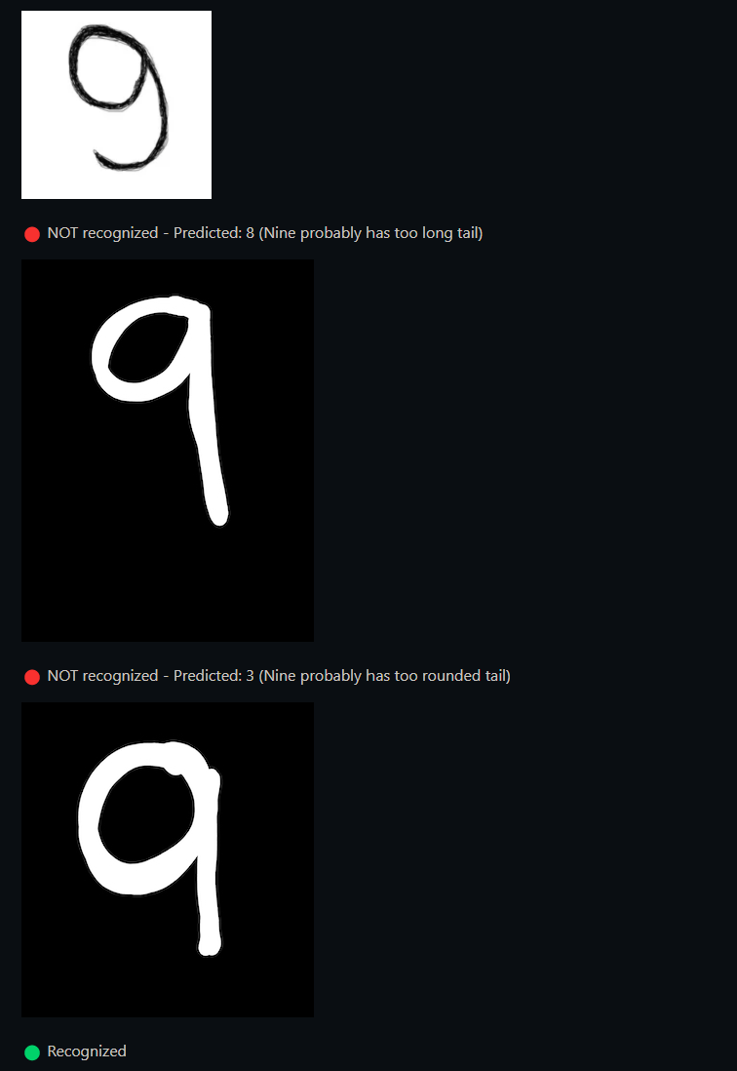
RESULTS/CONCLUSION

Slide 29
Thank you

